Slide 1

Market-provisioned social protection:
The Index-based Livestock Insurance (IBLI) Experiment in Northern Kenya
Chris Barrett
Cornell University
(on behalf of the ANU-Cornell-ILRI-Syracuse –
UC Davis IBLI research team)
Presentation to USAID BASIS AMA CRSP workshop
“Building Resilience and Assets for Food Security:
Evidence and Implications for Feed the Future”
29-30 September 2011
Washington, DC

Slide 2
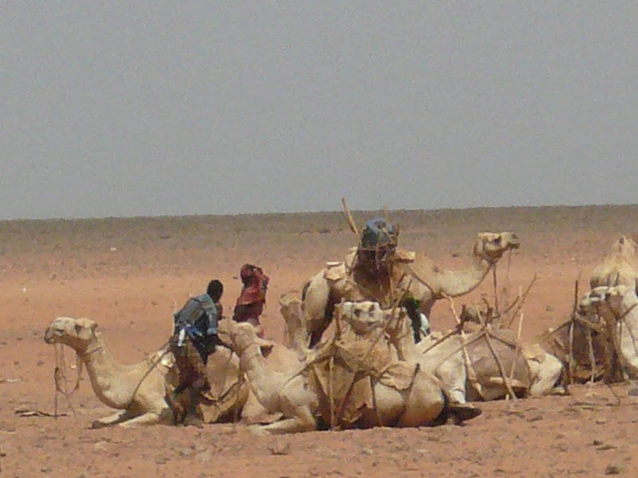
Motivation for IBLI
Arid and semi-arid lands (ASAL) cover ~ 2/3 of Africa, home to ~20mn pastoralists – who rely on extensive livestock grazing.
Pastoralist systems adapted to variable climate, but very vulnerable to severe drought events. Big herd losses cause humanitarian crisis.
This prompted a DfID-funded cash transfer program paying ~ $15/indigent family/month.
Our question: might $7/year for catastrophic herd loss insurance keep vulnerable families from becoming indigent? A market-based form of social protection?

Slide 3
Piloting IBLI in Northern Kenya
But can insurance be sustainably offered in rangelands?
Conventional (individual) insurance unlikely to work:
  Transactions costs
  Moral hazard/adverse selection
Index insurance avoids problems that make individual insurance unprofitable for small, remote clients:
  No transactions costs of measuring individual losses
  Preserves effort incentives (no moral hazard) as no single individual can influence index.
  Adverse selection does not matter as payouts do not depend on the riskiness of those who buy the insurance
Index insurance can, in principle, be used to create an effective safety net to alter poverty dynamics and help address broad-scale shocks.

Slide 4
New commercial Index-Based Livestock Insurance (IBLI) product launched commercially in January 2010 in Marsabit District in northern Kenya. Two periods of IBLI retail sales (Jan-Feb 2010 & 2011).
Described in an online video: http://blip.tv/file/3757148
Based on technical design developed at Cornell using multiple longitudinal household data sets; refined and led in the field by the International Livestock Research Institute (ILRI) in collaboration with various university and private sector partners.
Now being adapted and extended to Ethiopia and expanded to other ASAL districts in Kenya, all led by ILRI, with support from USAID, DfID, EU, World Bank, etc.
Notes:
4

Slide 5
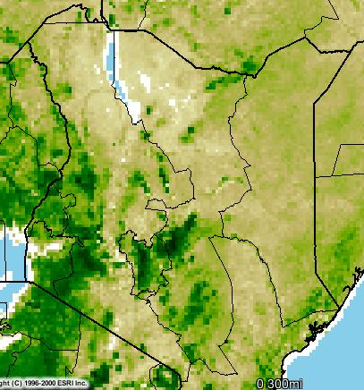
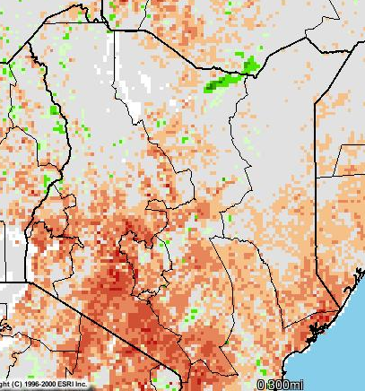
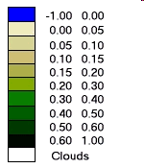
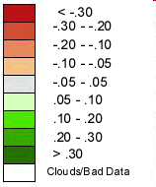
Designing IBLI for Northern Kenya
NDVI (Feb 2009, Dekad 3)
ZNDVI: Deviation of NDVI from long-term average
IBLI insures against area average herd loss predicted based on NDVI data fitted to past livestock mortality data.
Laisamis Cluster, zndvi (1982-2008)
Historical droughts
NASA NDVI Image Produced By: USGS-EROS Data Center. Source: FEWS-NET
Notes:
5

Slide 6
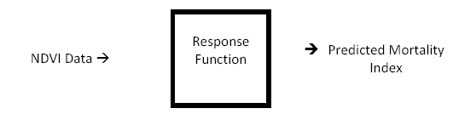

NDVI-based Livestock Mortality Index
The IBLI contract is based on area average livestock mortality predicted by remotely-sensed (satellite) information on vegetative cover (NDVI):
Notes:
6

Slide 7
Spatial Coverage
  Two separate area-specific “response functions” map NDVI into predicted livestock mortality.
  Five separate index coverage regions (2 in one area, 3 in the other).
  Upper Marsabit
  cluster
  Lower Marsabit
  cluster

Slide 8
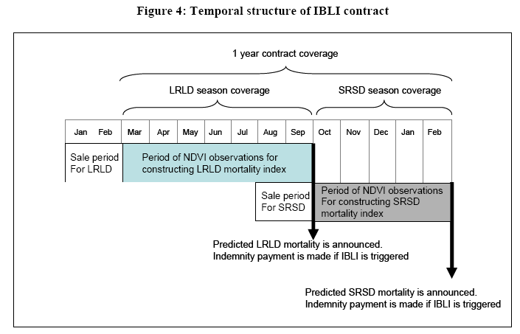
Temporal Coverage
  Year-long contract, with two prospective indemnity payment dates, following each dry season.
  Two marketing campaigns, just prior to rainy season.
  NDVI observed and index updated continuously.

Slide 9
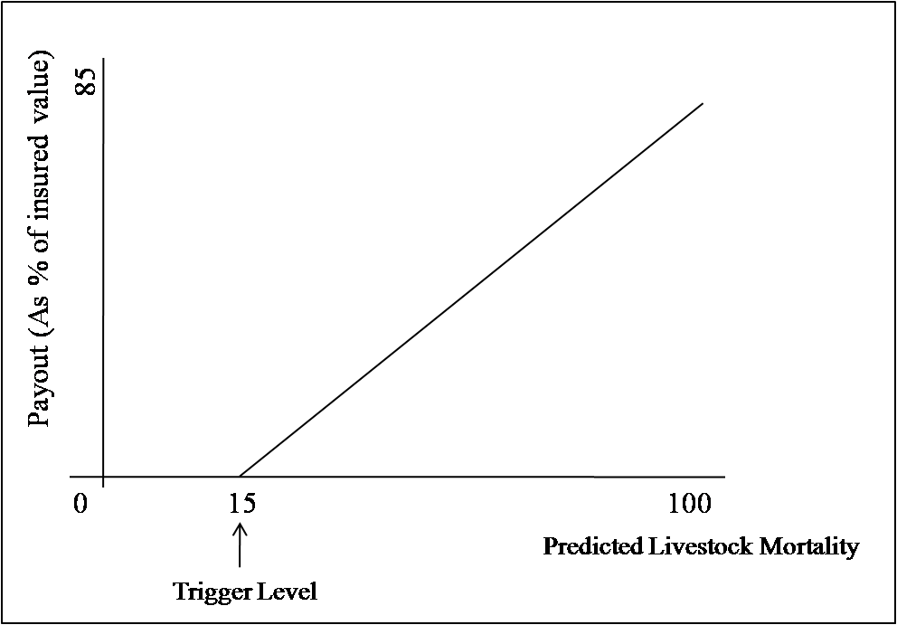
Risk Coverage and Pricing
Payoffs for predicted losses above 15% (“strike point”).
Trade off: Higher Strike → Lower Risk Coverage → Lower Cost
Contract Cluster | Consumer Price
Upper Marsabit | 5.5%
Lower Marsabit | 3.25%

Slide 10
Testing the Index Performance
Performance of predicted herd mortality rate in predicting area-average livestock mortality observed in longitudinal data
  Out-of-sample prediction errors within 10% (especially in bad years)
  Predicts historical droughts well
Out of sample

Slide 11
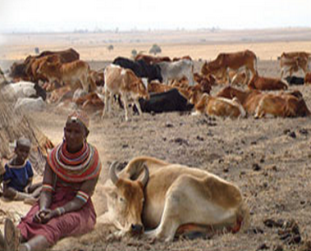
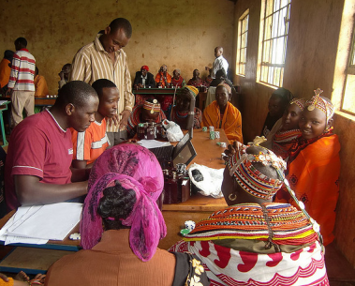
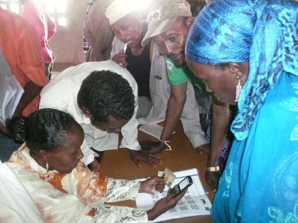
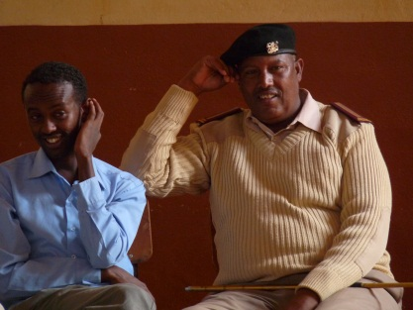
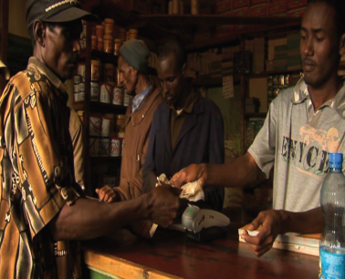
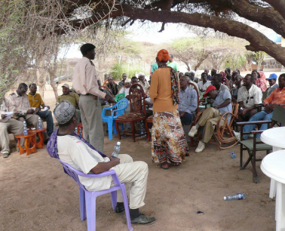
IBLI Implementation
Commercially launched in January 2010
Two sales periods of varying experience:
    Jan/Feb 2010: Sold 1979 contracts. 2.8 TLU insured/contract. Premiums collected ~ $46,597. Value of livestock covered ~$1,200,000
    Jan/Feb 2011: Sold 638 contracts. 1.7 TLU insured/contract.
    Premiums collected ~ $8,185 Value of livestock covered
    ~$218,000
Key ongoing considerations/challenges:
    Delivery Channel
    Extension/Education
    Information Dissemination and Trust Building
    Regulation

Slide 12
Likely first indemnity payout coming in a few weeks!

Slide 13
Impact Evaluation Under Way
  Confounding factor: ongoing implementation of cash transfer (HSNP)
    Encouragement design
    Insurance education game: played among 50% sample in game site
    Discount coupon on the first 15 TLU insured: (no subsidy for 40% of sample, 10%-60% subsidies for the rest). 255/924 bought IBLI 1st year.
Sample selection: 924 households
  Sample/site proportional to relative pop. sizes
  For each site, random sampling stratified by livestock wealth class
  Annual repeat survey: 2009, 2010, 2011 round about to go into field.
 | IBLI Game | No IBLI Game
HSNP | 4 sites | 4 sites
No HSNP | 5 sites | 3 control sites

Slide 14
Core impact evaluation questions
1) For whom is IBLI most attractive and effective?
- simulation-based answer: IBLI most valuable among the vulnerable non-poor
- simulation-based and WTP survey based answer: Highly price elastic demand for IBLI
2) Does IBLI induce increased asset accumulation and escapes from poverty? Does it reduce asset loss and falls into poverty? How does it perform relative to cash transfers? Are there spillover effects on the stockless poor?
simulation-based answers: Yes on first two points. Don’t know on latter two questions.
Use survey data to test these hypotheses in quasi-experimental setting with real insurance in a survey designed to test IBLI versus/with cash transfers under Kenya’s new Hunger Safety Nets Program.

Slide 15
What we are learning
Women comprise a significant share of demand – 42% of contract purchases >>the share of herds they control.
A considerable lack of understanding amongst a good portion of those who purchased (e.g., 33-48% of policy holders don’t know or are incorrect about basic contract terms).
  So why do they purchase?
  What are the implications of this misinformed demand?
Nevertheless, those who purchase are significantly more likely to understand key features of the product.
  Improve on extension messaging and targeting?
  Need further analysis on relationship between understanding and other key covariates.
Relative to more costly games, VIPs doing well.
Communication needs to be about index variable (predicted mortality rates), not input (range conditions).

Slide 16
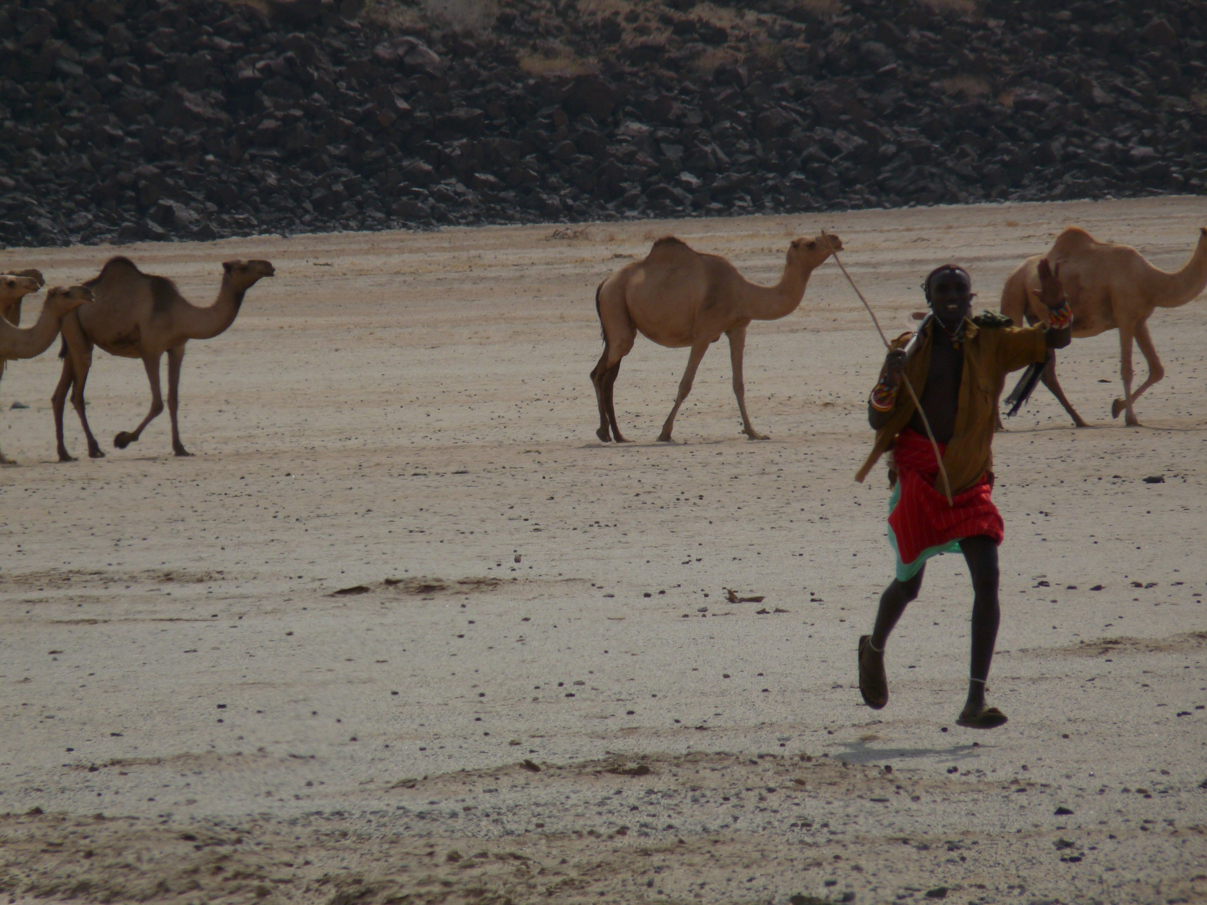
Thank you and stay tuned!
For more information please visit:
www.ilri.org/ibli/
Or watch,
http://blip.tv/file/3757148
Notes:
16

